Slide 1
Power BI app on Business Central environment telemetry
March 2023 release

Slide 2
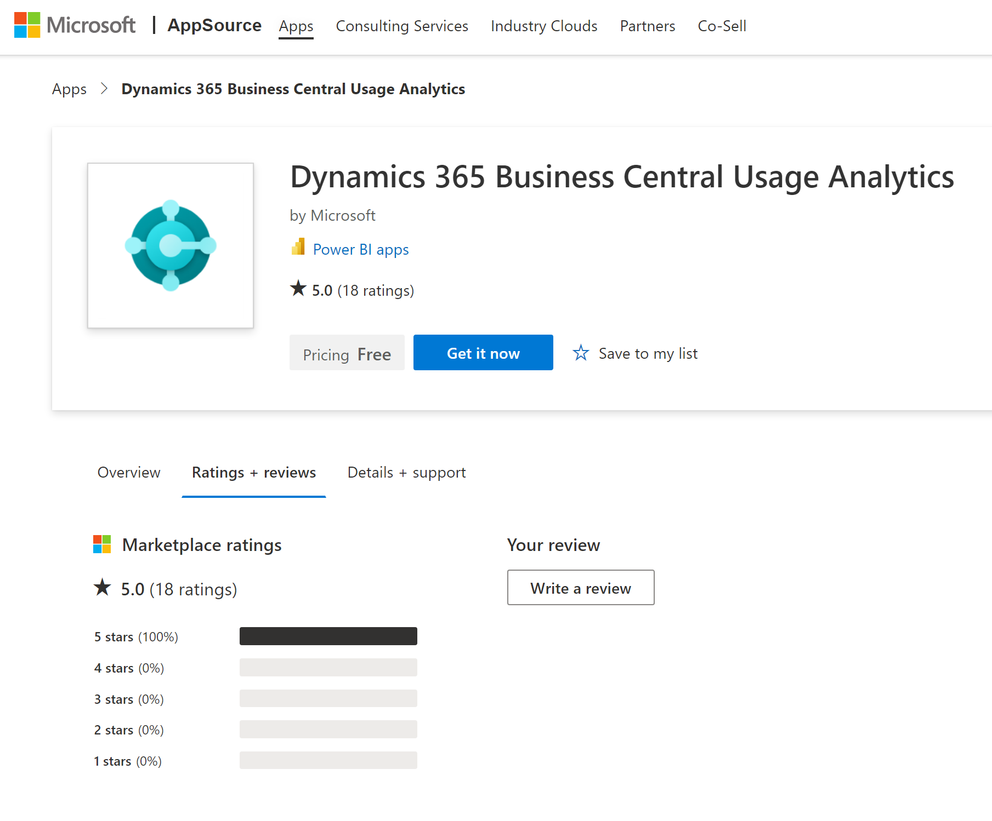
Install/update from Appsource (on March 1, 2023)

Slide 3
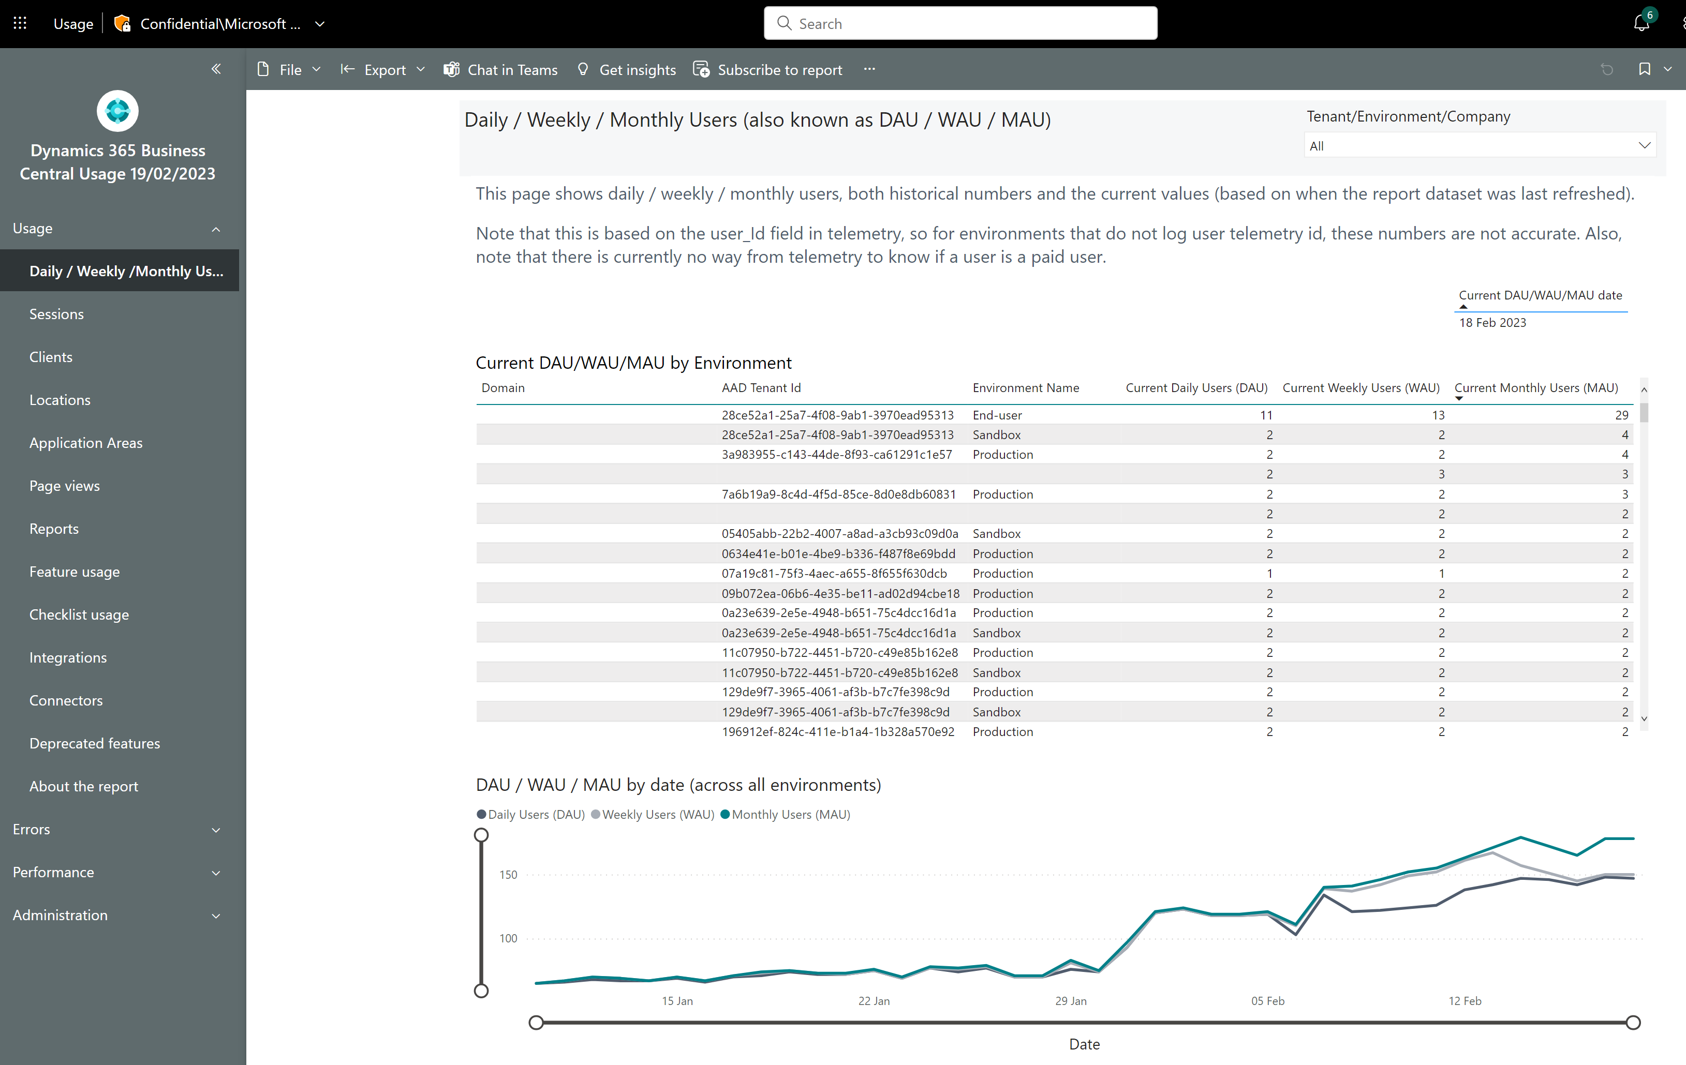
Usage report: new DAU/WAU/MAU page

Slide 4
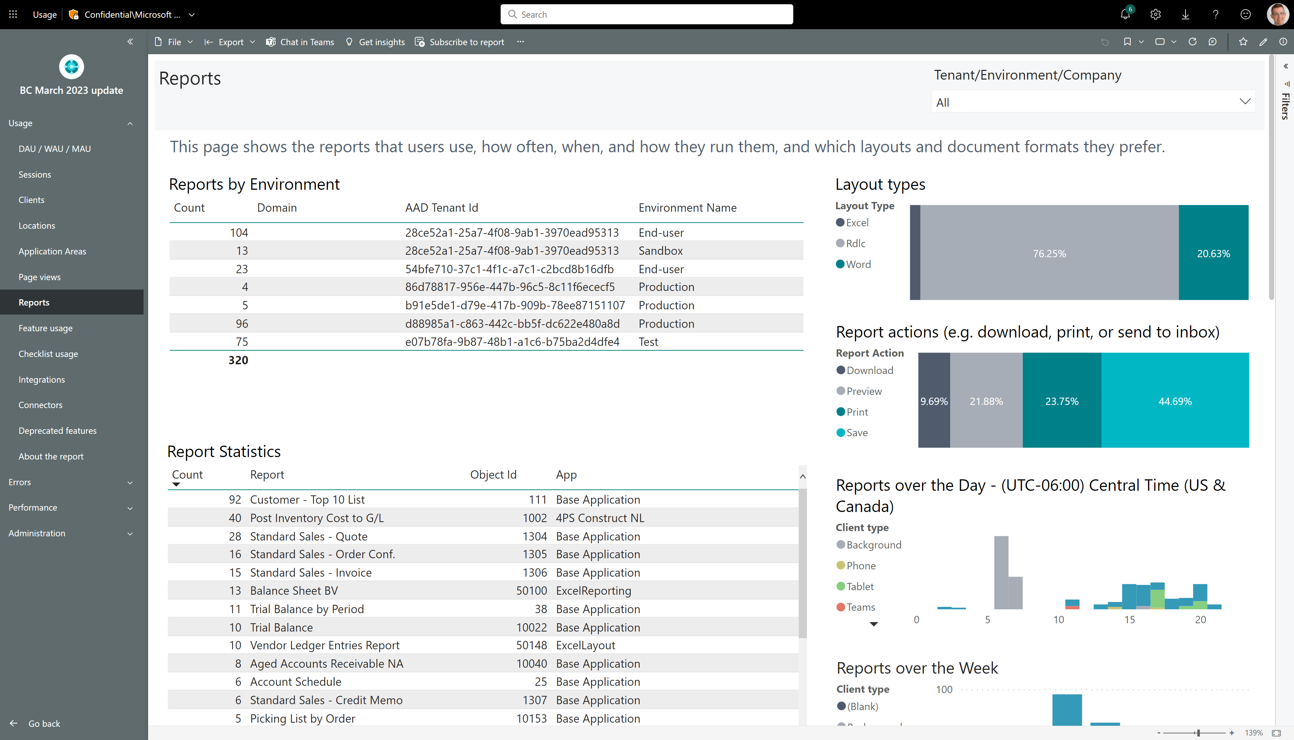
Usage report: X by Environment visuals added on pages pageviews, reports, Feature Usage, Checklist usage, Integrations, Connectors, and Deprecated features

Slide 5
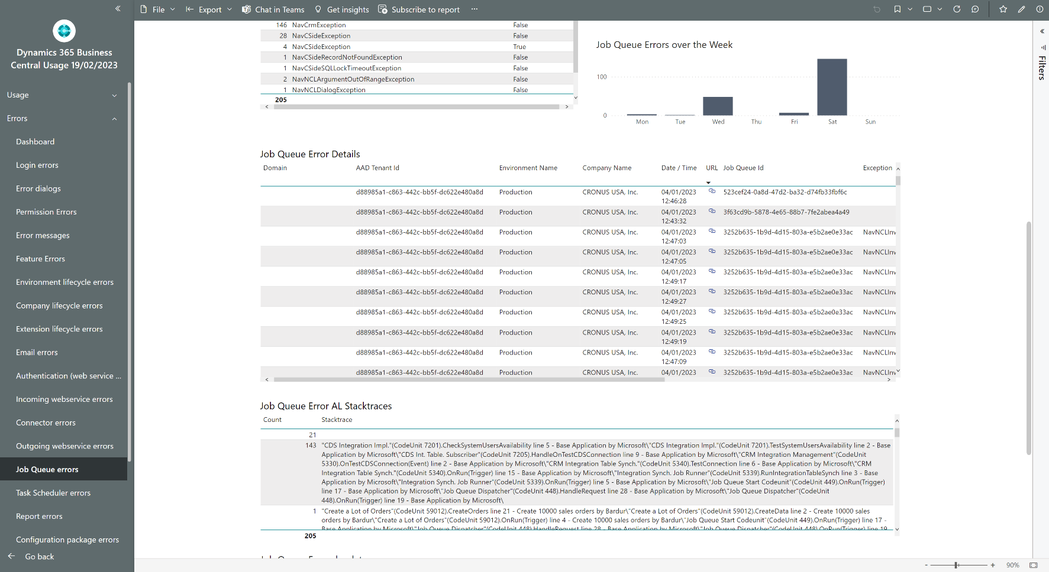
Error report: Job Queue
AL stacktrace added to job queue telemetry
Allows partners to troubleshoot failed job queue entries

Slide 6
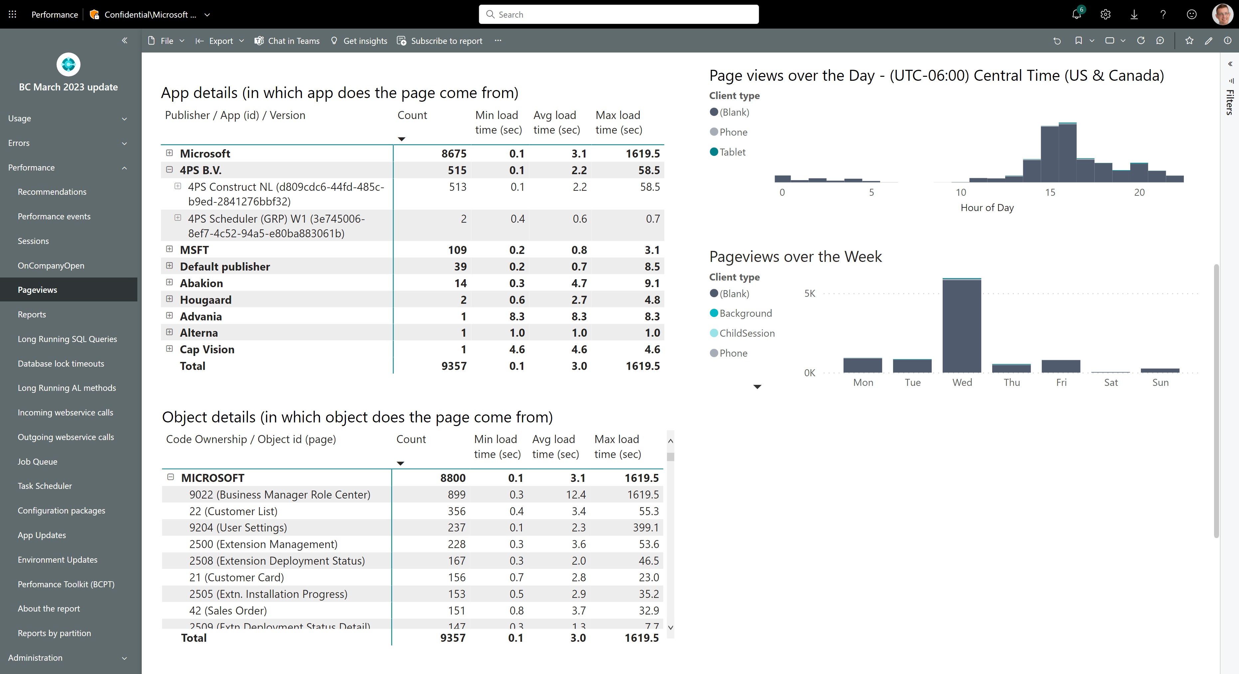
Performance report: Per app/per object visuals added to pageview page

Slide 7
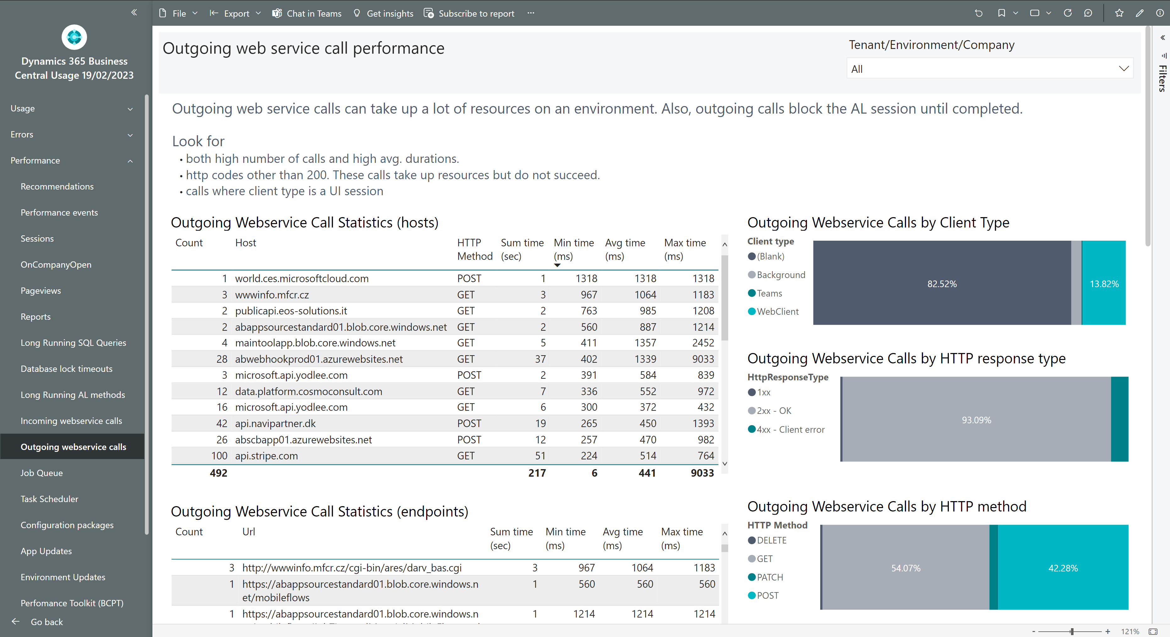
Performance Client type in Outgoing web service telemetry
Outgoing web service telemetry (eventId RT0019) include details on client type (version 21.4) in the custom dimensions clientType
Allows partners to find outgoing web service calls that happens in UI sessions as these calls block AL execution and hence UI responsiveness.

Slide 8
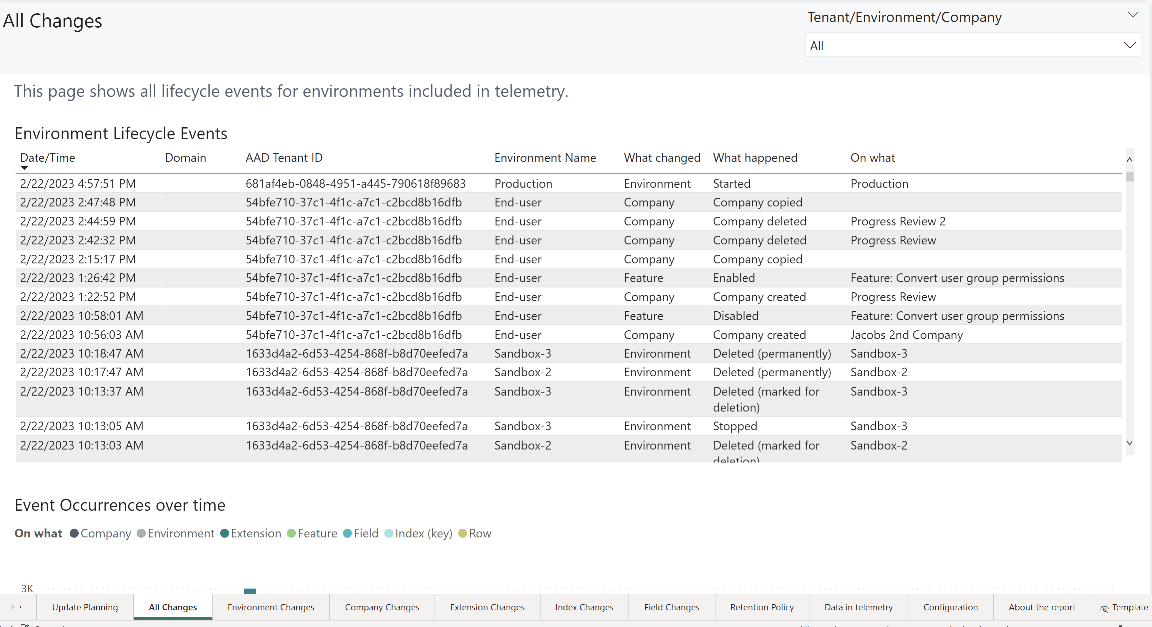
Administration: See environment soft/hard deletes and recovery operations in the All changes report in Power BI

Slide 9
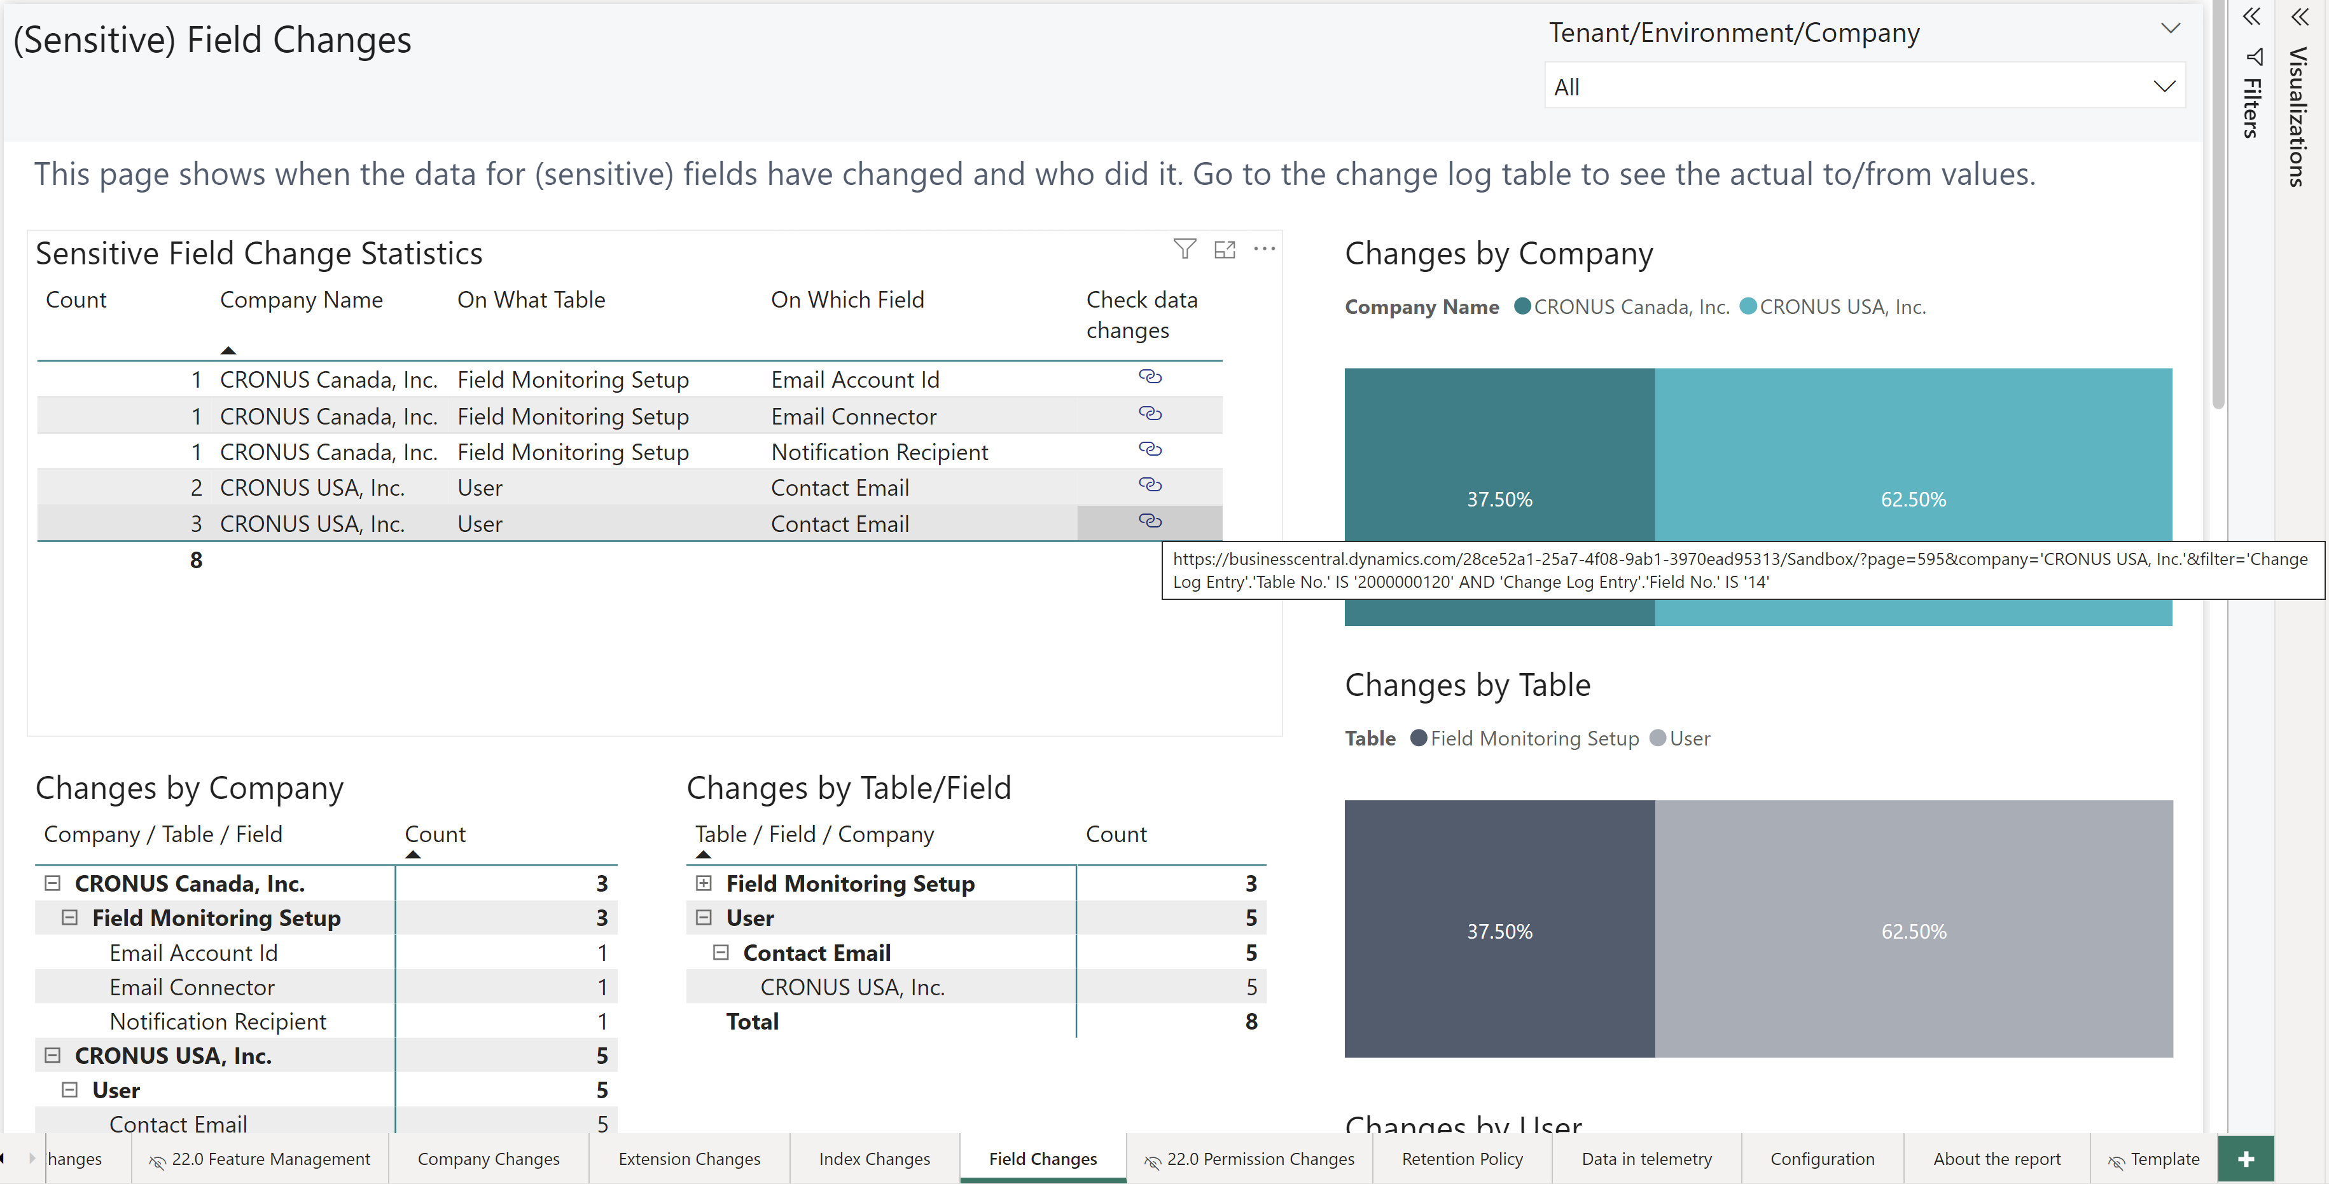
Administration, Field Changes: Admin can now drill through to what data changed

Slide 10
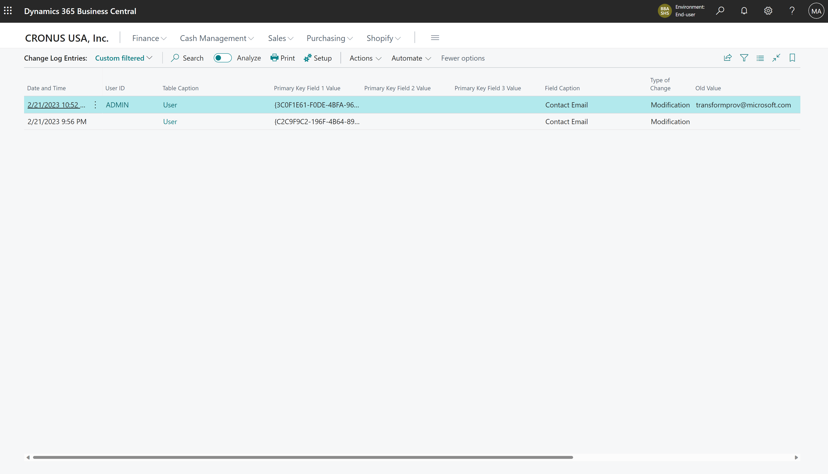
Link goes to Change Log page filtered to the specified Table.Field

Slide 11
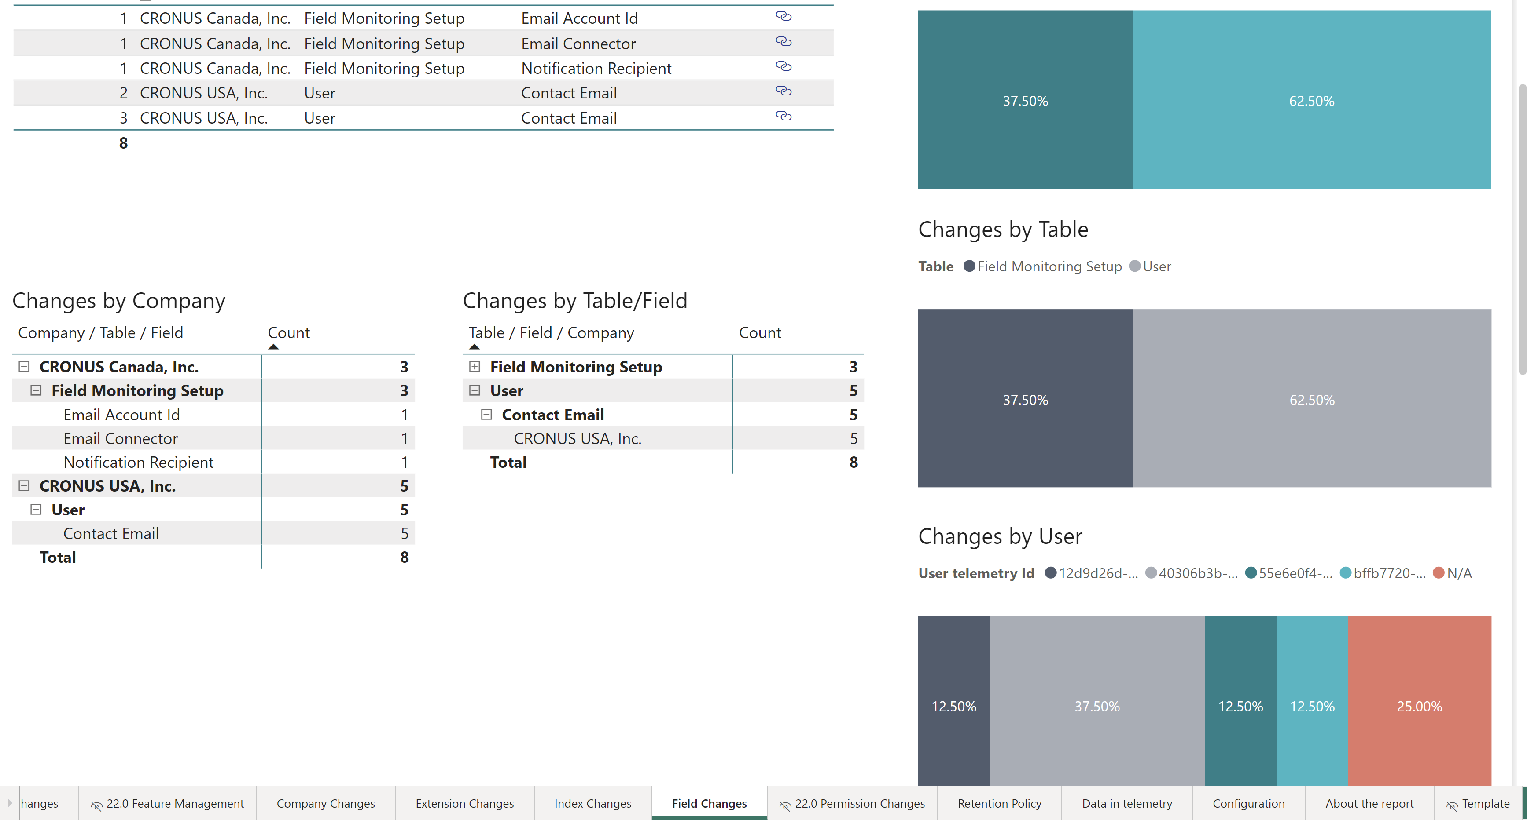
Field Changes: Admin can now analyze data changes by company or table/field

Slide 12
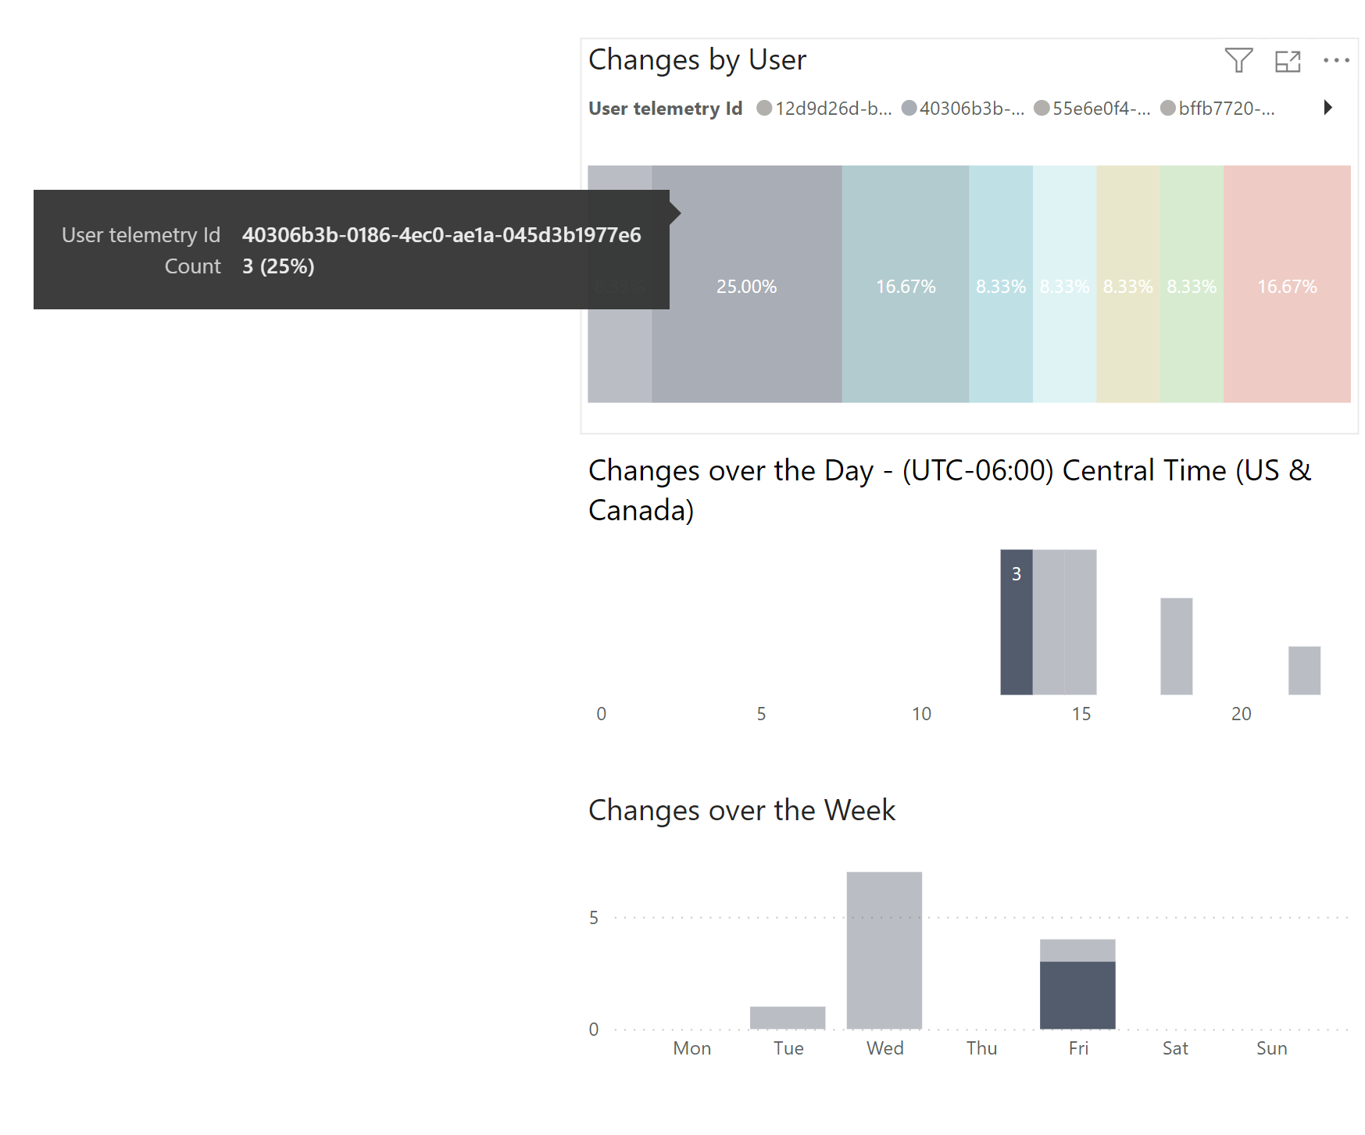
Field Changes: Admin can now analyze (suspect?) data changes user, time of day, and weekday

Slide 13
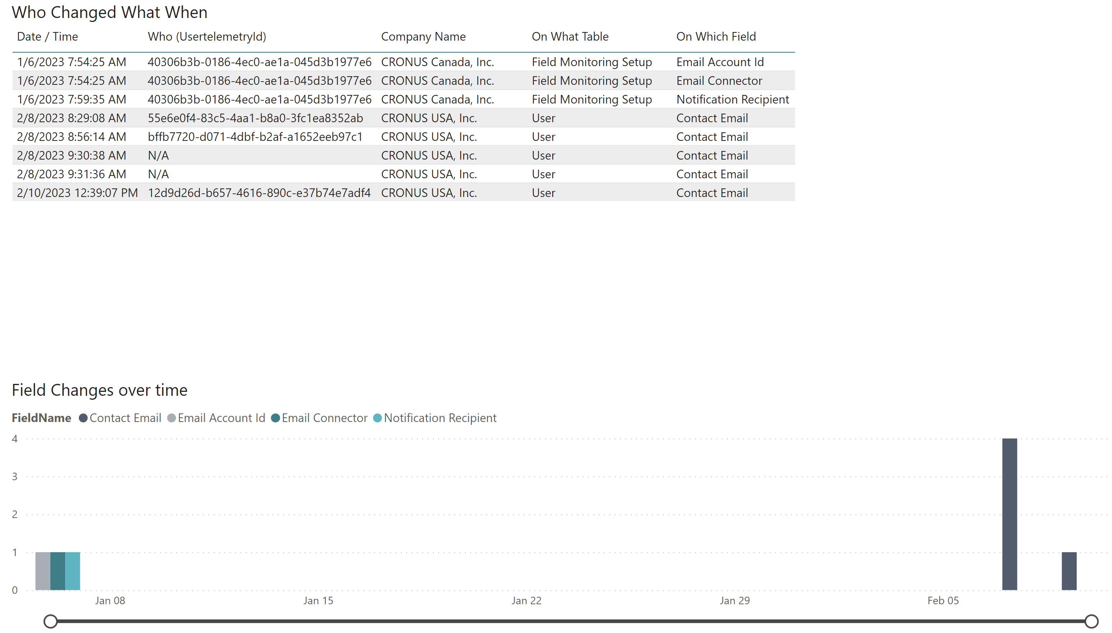
Field Changes: Admin can now see details of Who Changed What When

Slide 14
Beta release available now
Install from
aka.ms/bctelemetryreportbeta

Slide 15
Beta release available now
Install from
aka.ms/bctelemetryreportbeta
(you know you want it)

Slide 16
Beta release available now
Install from
aka.ms/bctelemetryreportbeta
(do it now…)

